Slide 1
System Evolution
Large systems have a long lifetime. They must evolve to meet changing requirements.
Evolution is inherently costly :
  Changes must be analysed from a technical and business perspective.
  Sub-systems interact so unanticipated problems can arise.
  There is rarely a rationale for original design decisions.
  System structure is corrupted as changes are made to it.
Existing systems which must be maintained are sometimes called legacy systems.

Slide 2
The Emergence of Agile Methods
The additional process steps, roles, and artifacts helped many teams to enjoy higher success rates and more satisfied customers.
Unfortunately, many projects failed attempting to use the same techniques.
Some projects got lost in the documents and never implemented any code, missing the window of opportunity for the software.
Others did not leave enough time at the end for implementation and testing.

Slide 3
Principles behind the Agile Manifesto
Software Engg. follow these principles:
• Highest priority is to satisfy the customer through early and continuous delivery of valuable software.
• Welcoming changing requirements, even late in development. Agile processes harness change for the customer’s competitive advantage.
• Deliver working software frequently, from a couple of weeks to a couple of months, with a preference to shorter time scales.
• Business people and developers must work together daily throughout the project.

Slide 4
Principles behind the Agile Manifesto
• Build projects around motivated individuals. Give them the environment and support they need, and trust them to get the job done.
The most of client and effective method of conveying information to and within a development team is face-to-face conversation.
Working software is the primary measure of progress.
• Agile processes promote sustainable development. The sponsors, developers, and users should be able to maintain a constant pace indefinitely.

Slide 5
Principles behind the Agile Manifesto
Continuous attention to technical excellence and good design enhances agility.
Simplicity the art of maximizing the amount of work not done — is essential.
The best architectures, requirements, and designs emerge from self-organized teams.
At regular intervals, the team seeks feedbacks from clients

Slide 6
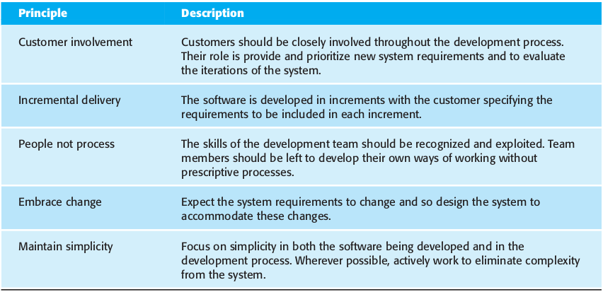
Principles Highlighted in textbook :

Slide 7
Software Project Management
Concerned with activities involved in ensuring
that software is delivered on time and on
schedule.
Aforesaid goes in accordance with the requirements of the organisations developing and procuring the software.
Project management is needed because software development is always subject to the budget and schedule constraints that are set by the organisation who manage all software development activities.

Slide 8
Project Management Distinctions
The product is intangible.
The product is uniquely flexible.
Software engineering is not recognized as an engineering discipline with the same status as
mechanical, electrical engineering, etc.
The software development process is not
standardised.
Many software projects are 'one-off' the projects.

Slide 9
Project Management activities
Proposal writing.
Project planning and scheduling.
Project costing.
Project monitoring and reviews.
Personnel selection and evaluation.
Report writing and presentations.

Slide 10
Project Planning
Probably the most time-consuming is Project Management activity.
Continuous activity from initial concept through
to system delivery. Plans must be regularly revised as new information becomes available.
Various types or approaches of plans may be developed, supporting the main software project plan that is mainly concerned with schedule and budget.

Slide 11
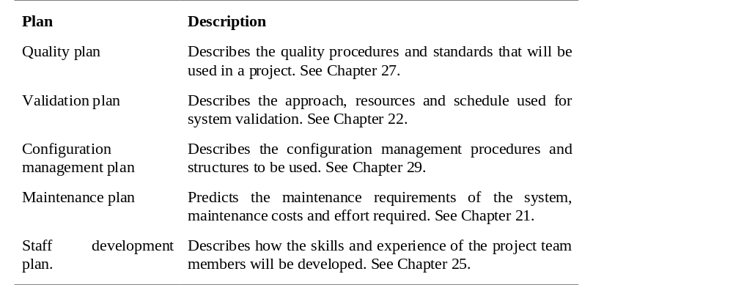
Types of project plan

Slide 12
Project Planning Process
Establish the project constraints
Make initial assessments of the project parameters
Define project milestones and deliverables
while project has not been completed or cancelled loop
Draw up project schedule
Initiate activities according to schedule
Wait ( for a while )
Review project progress
Revise estimates of project parameters
Update the project schedule
Re-negotiate project constraints and deliverables
if ( problems arise ) then
Initiate technical review and possible revision
end if
end loop

Slide 13
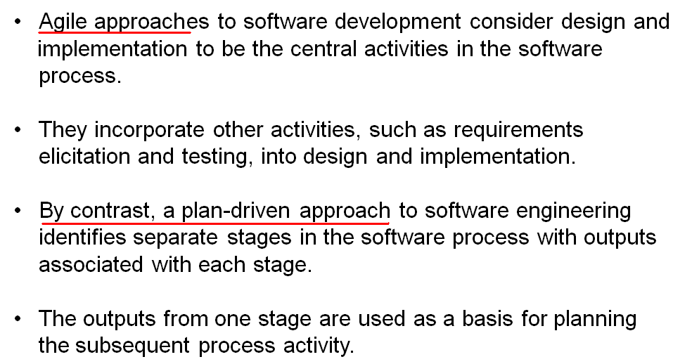
Plan-driven v/s Agile Development

Slide 14
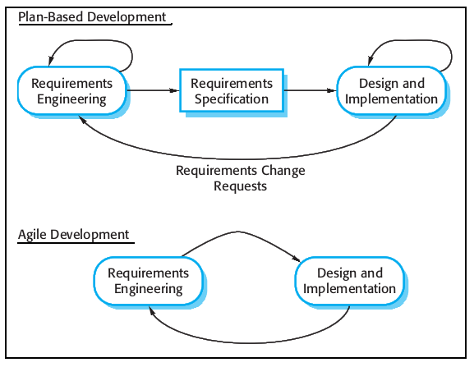

Slide 15
Project Plan Structure
Introduction.
Project organisation.
Risk analysis.
Hardware and software resource requirements.
Work breakdown.
Project schedule.
Monitoring and reporting mechanisms.

Slide 16
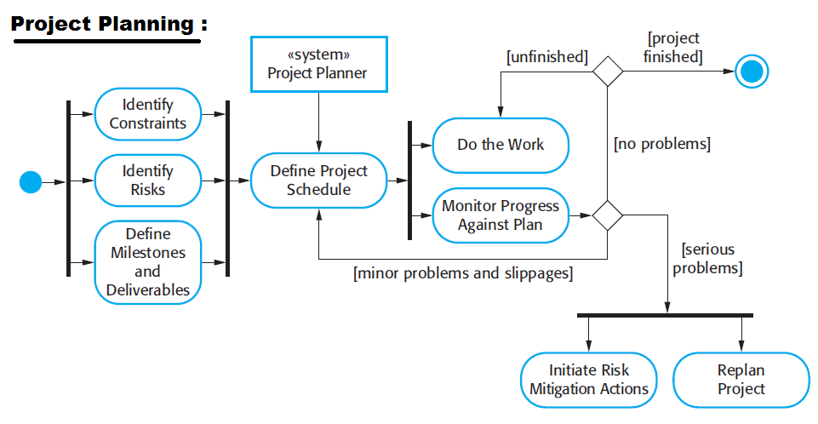

Slide 17
Familiar Agile Methods used
The number of methods that claim to align the Agile Manifesto will continue to grow with the popularity of their use.
• Extreme Programming
• SCRUM
• Crystal
• Feature Driven Development FDD
• Lean Development LD
• Adaptive Software Development ASD
• Dynamic Software Development Methods DSDM

Slide 18
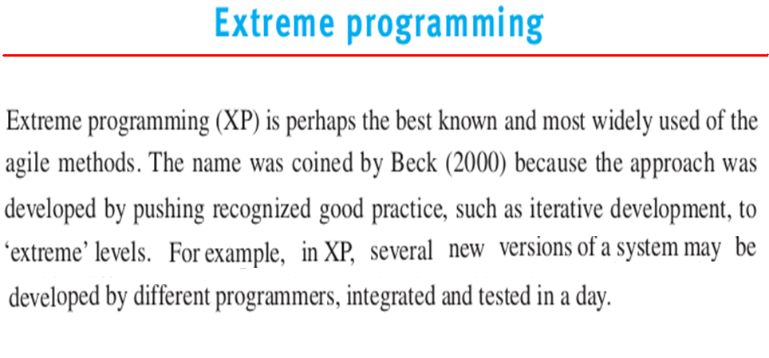

Slide 19
Extreme Programming
An approach to development based on the development and delivery of very small functions in increments an existing.
Relies on constant code improvement for adaptability or compatibility.
user involvement in the development team.
Pair wise programming to review program approaches of each other to come out with the best solution.

Slide 20
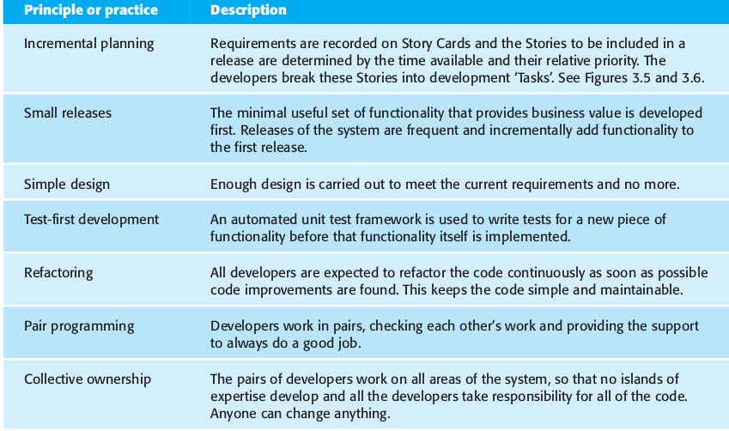
Principles of Extreme Programing

Slide 21
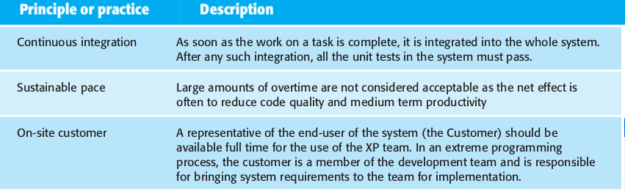

Slide 22
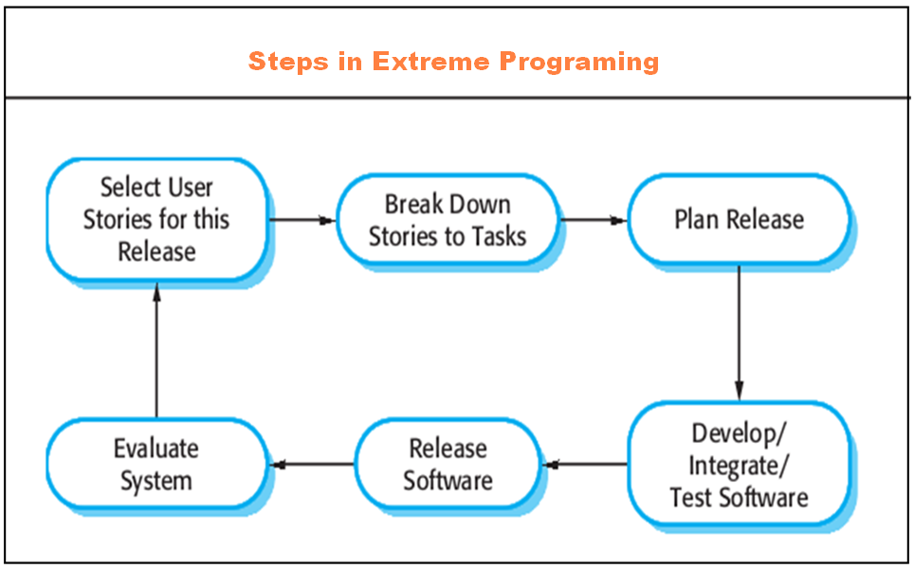

Slide 23
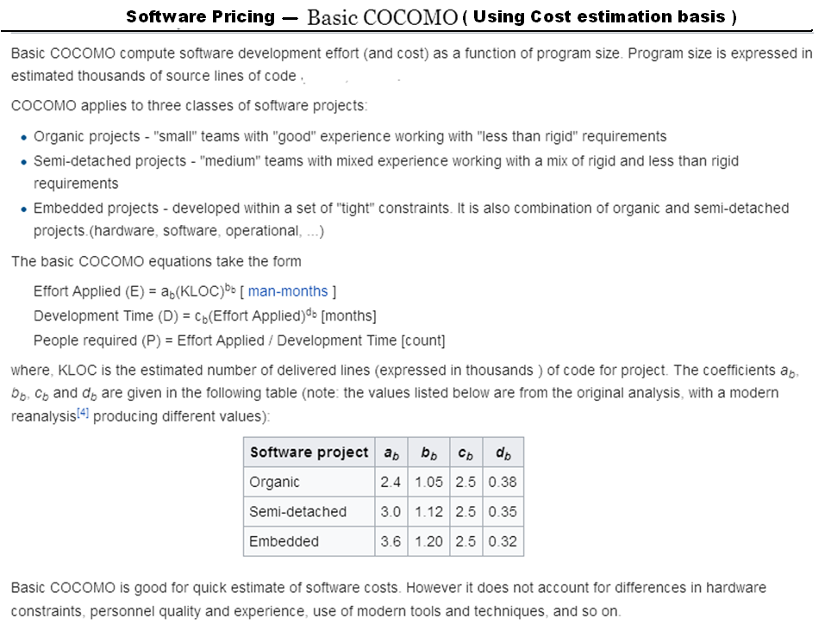

Slide 24
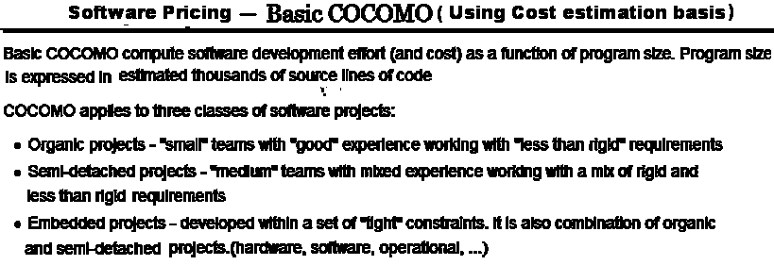

Slide 25
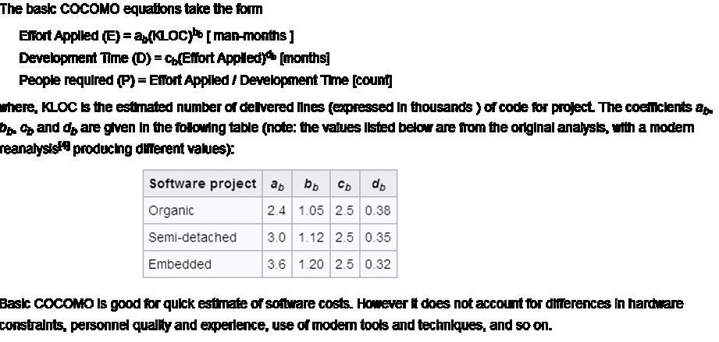

Slide 26
Activity Organization
Activities in a project should be organised to produce tangible outputs for management to judge progress.
Milestones are the end-point of a process activity.
Deliverables are project results delivered to customers.
The traditional process allows for the straightforward definition of progress milestones.

Slide 27
Project Scheduling
Split project into tasks and estimate time and resources required to complete each task.
Organize tasks concurrently to make optimal
use of workforce.
Minimize task dependencies to avoid delays
caused by one task waiting for another to complete.
Dependent on project managers intuition and experience.

Slide 28
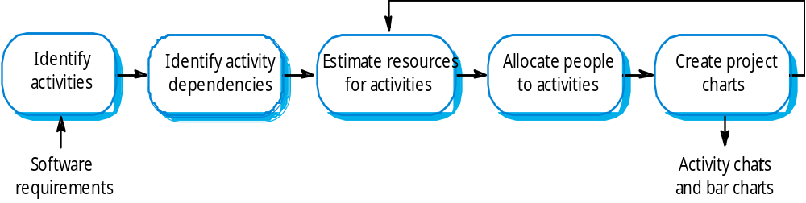
The Project Scheduling Process

Slide 29
Scheduling Representation:
(Using Graphs and activity diagram)
Graphical notations used to illustrate the project schedule.
Show project breakdown into tasks. Tasks should not be too small & should take about atleast week or two.
Activity charts show task dependencies and the critical path.
Bar charts show schedule against calendar time.

Slide 30
Bar Charts And Activity Networks
Graphical notations used to illustrate the project schedule.
Show project breakdown into tasks. Tasks should not be too small. They should take about a week or two.
Activity charts show task dependencies and the the critical path.
Bar charts show schedule against calendar time.

Slide 31
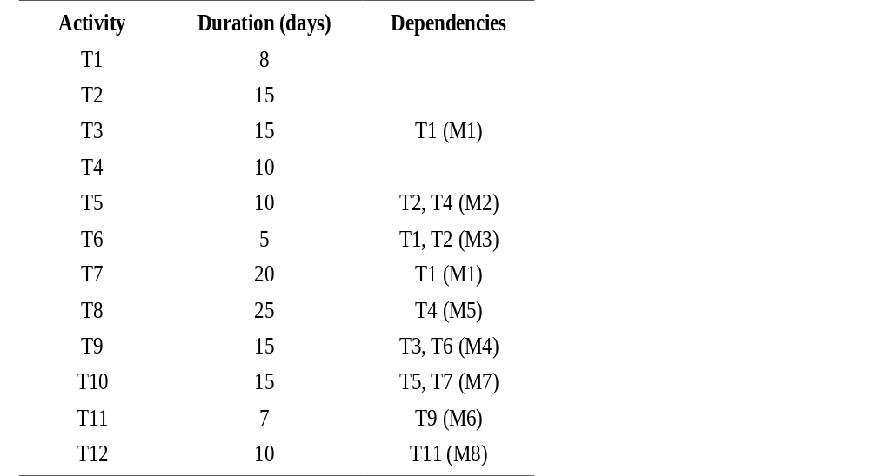
Task Durations And Dependencies

Slide 32
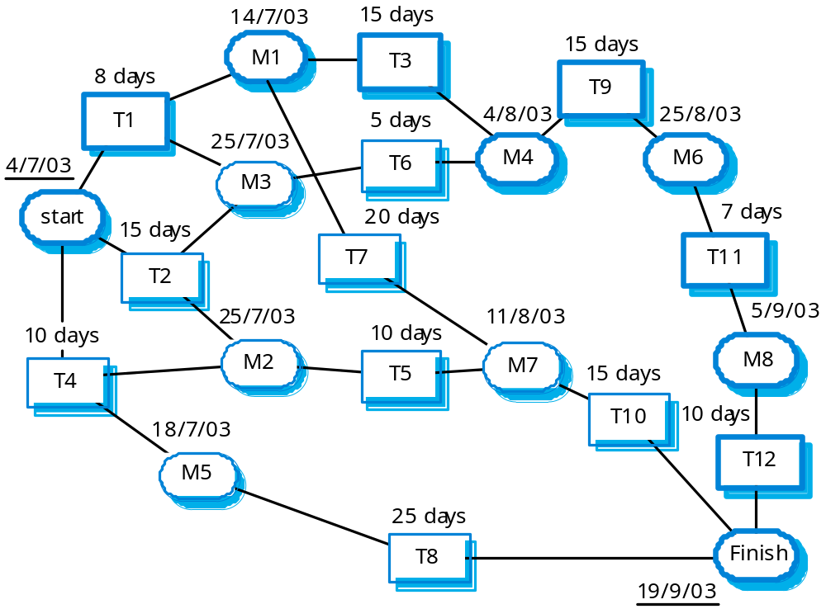
Activity Network

Slide 33
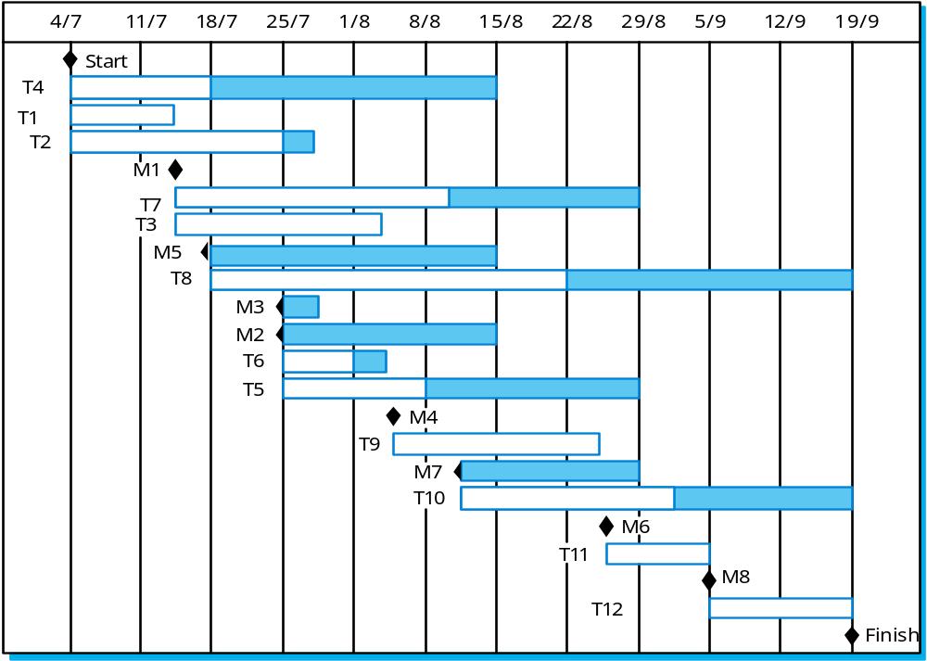
Activity Timeline

Slide 34
Scheduling Problems
Estimating the difficulty of problems and hence the cost of developing a solution is hard.
Productivity is not proportional to the number of people working on a task.
Adding people to a late project makes it later because of communication overheads.
The unexpected always happens. Always allow contingency in planning.

